Slide 1
Smart Healthcare
By
Parthkumar Panchal(16BCE115)
Manan Charania(16BCE100)

Slide 2
What is Smart Healthcare?
The term ‘Smart Health Technology’ combines the term ‘Smart Technology’ with health, i.e. smart technologies used for health purposes. Smart Health Technologies are at least in part physical, and can include the means to interact and engage with data by way of e.g. Virtual or Augmented Reality as well as other forms of data representation.

Slide 3
What we are building?
We are building a WebApp which facilitate users in making better health decisions.
It helps patients maintain their regular medication.
It helps users to maintain their diet and fitness.
It brings medical advice to the rural areas where there is a lack of doctors.

Slide 4
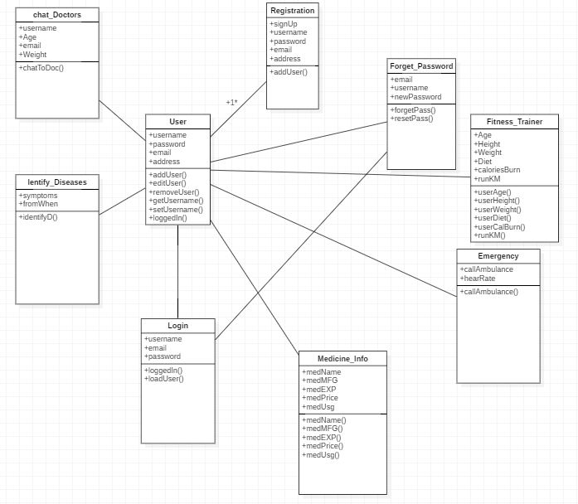
Class Diagram

Slide 5
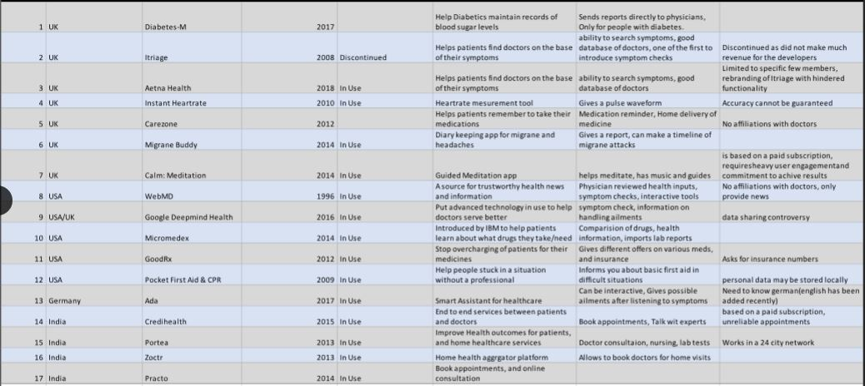
Comparison of healthcare apps from Different Countries

Slide 6
Implementing Modules
Authentication
Fitness Tips
Disease prediction by symptoms
Chat with doctors
Medicine Information

Slide 7

Authentication Module

Slide 8
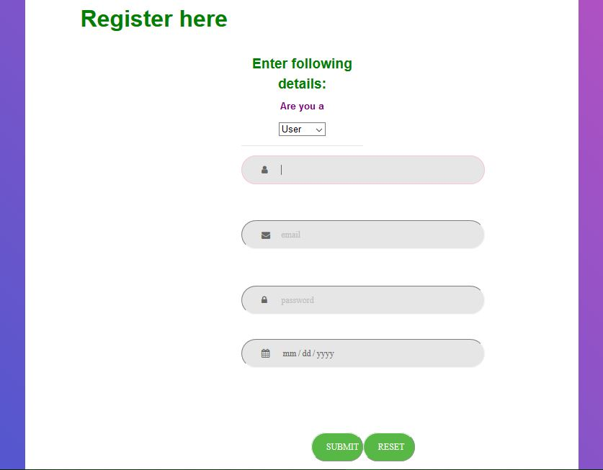

Slide 9
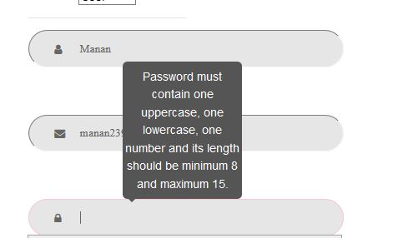

Slide 10
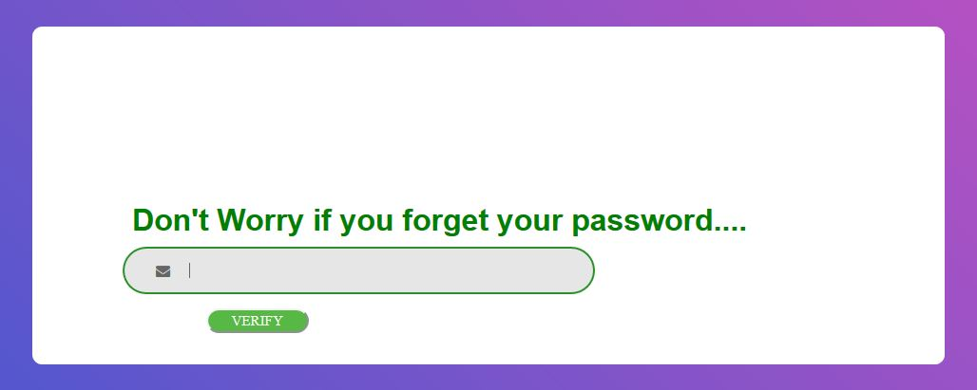

Slide 11
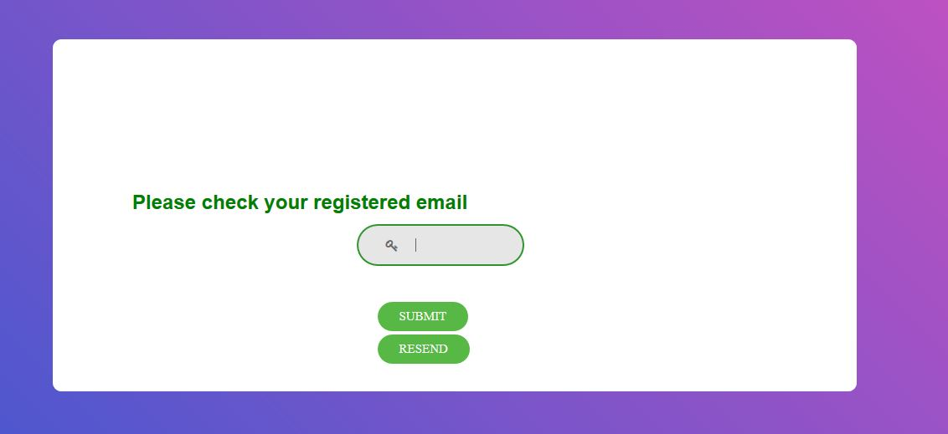

Slide 12


Slide 13
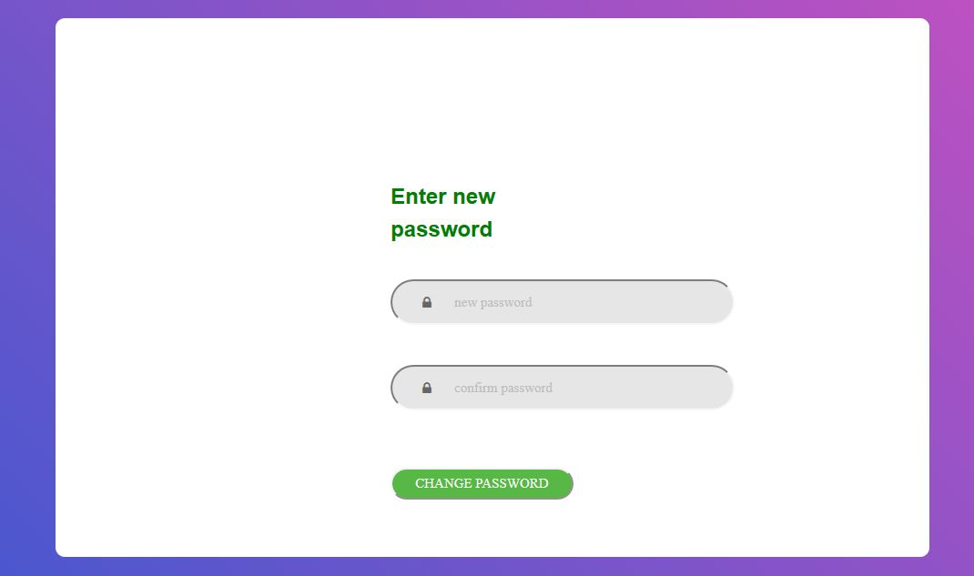

Slide 14
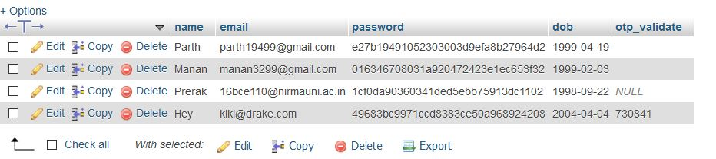

Slide 15
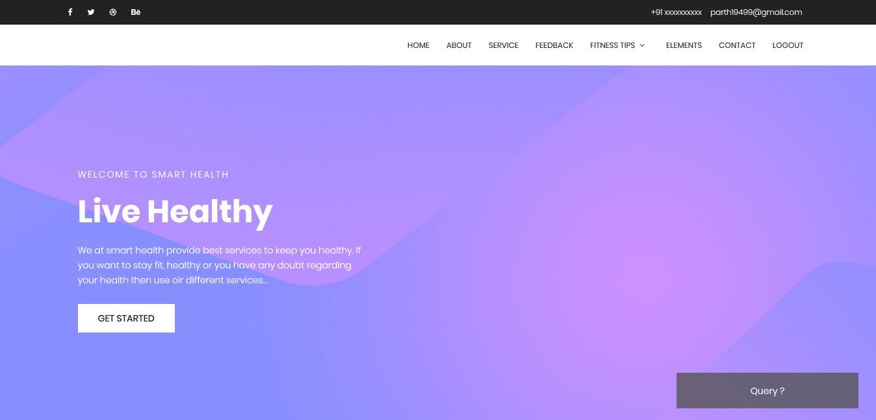

Slide 16
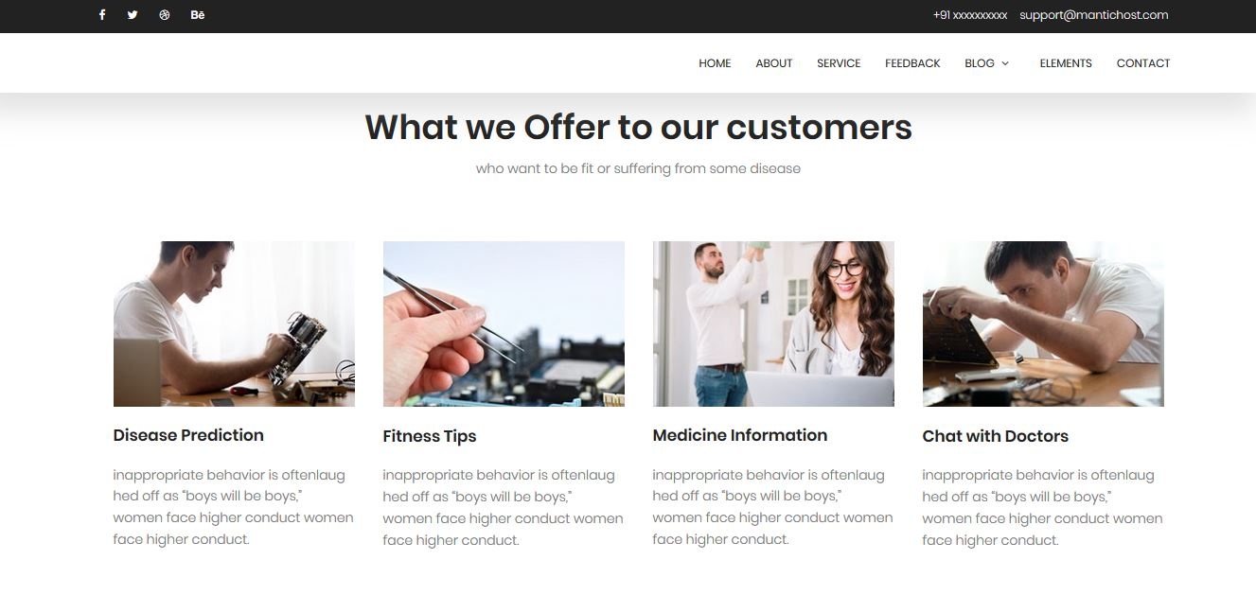

Slide 17
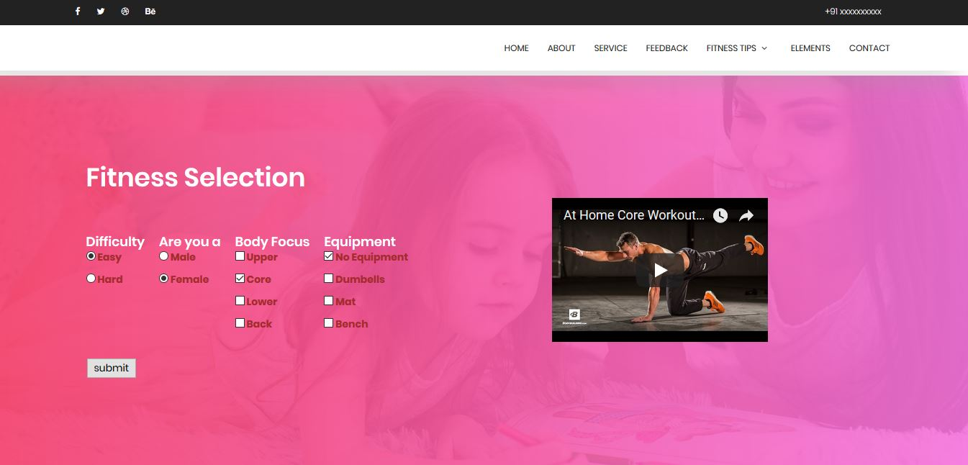

Slide 18
Novelty features
We are implementing our website in 3 different languages.
Hindi, Gujarati, English.
Identify Disease from Symptoms.

Slide 19
Thank You

